Slide 1

13th Sunday after Pentecost
August 23, 2026

Slide 2
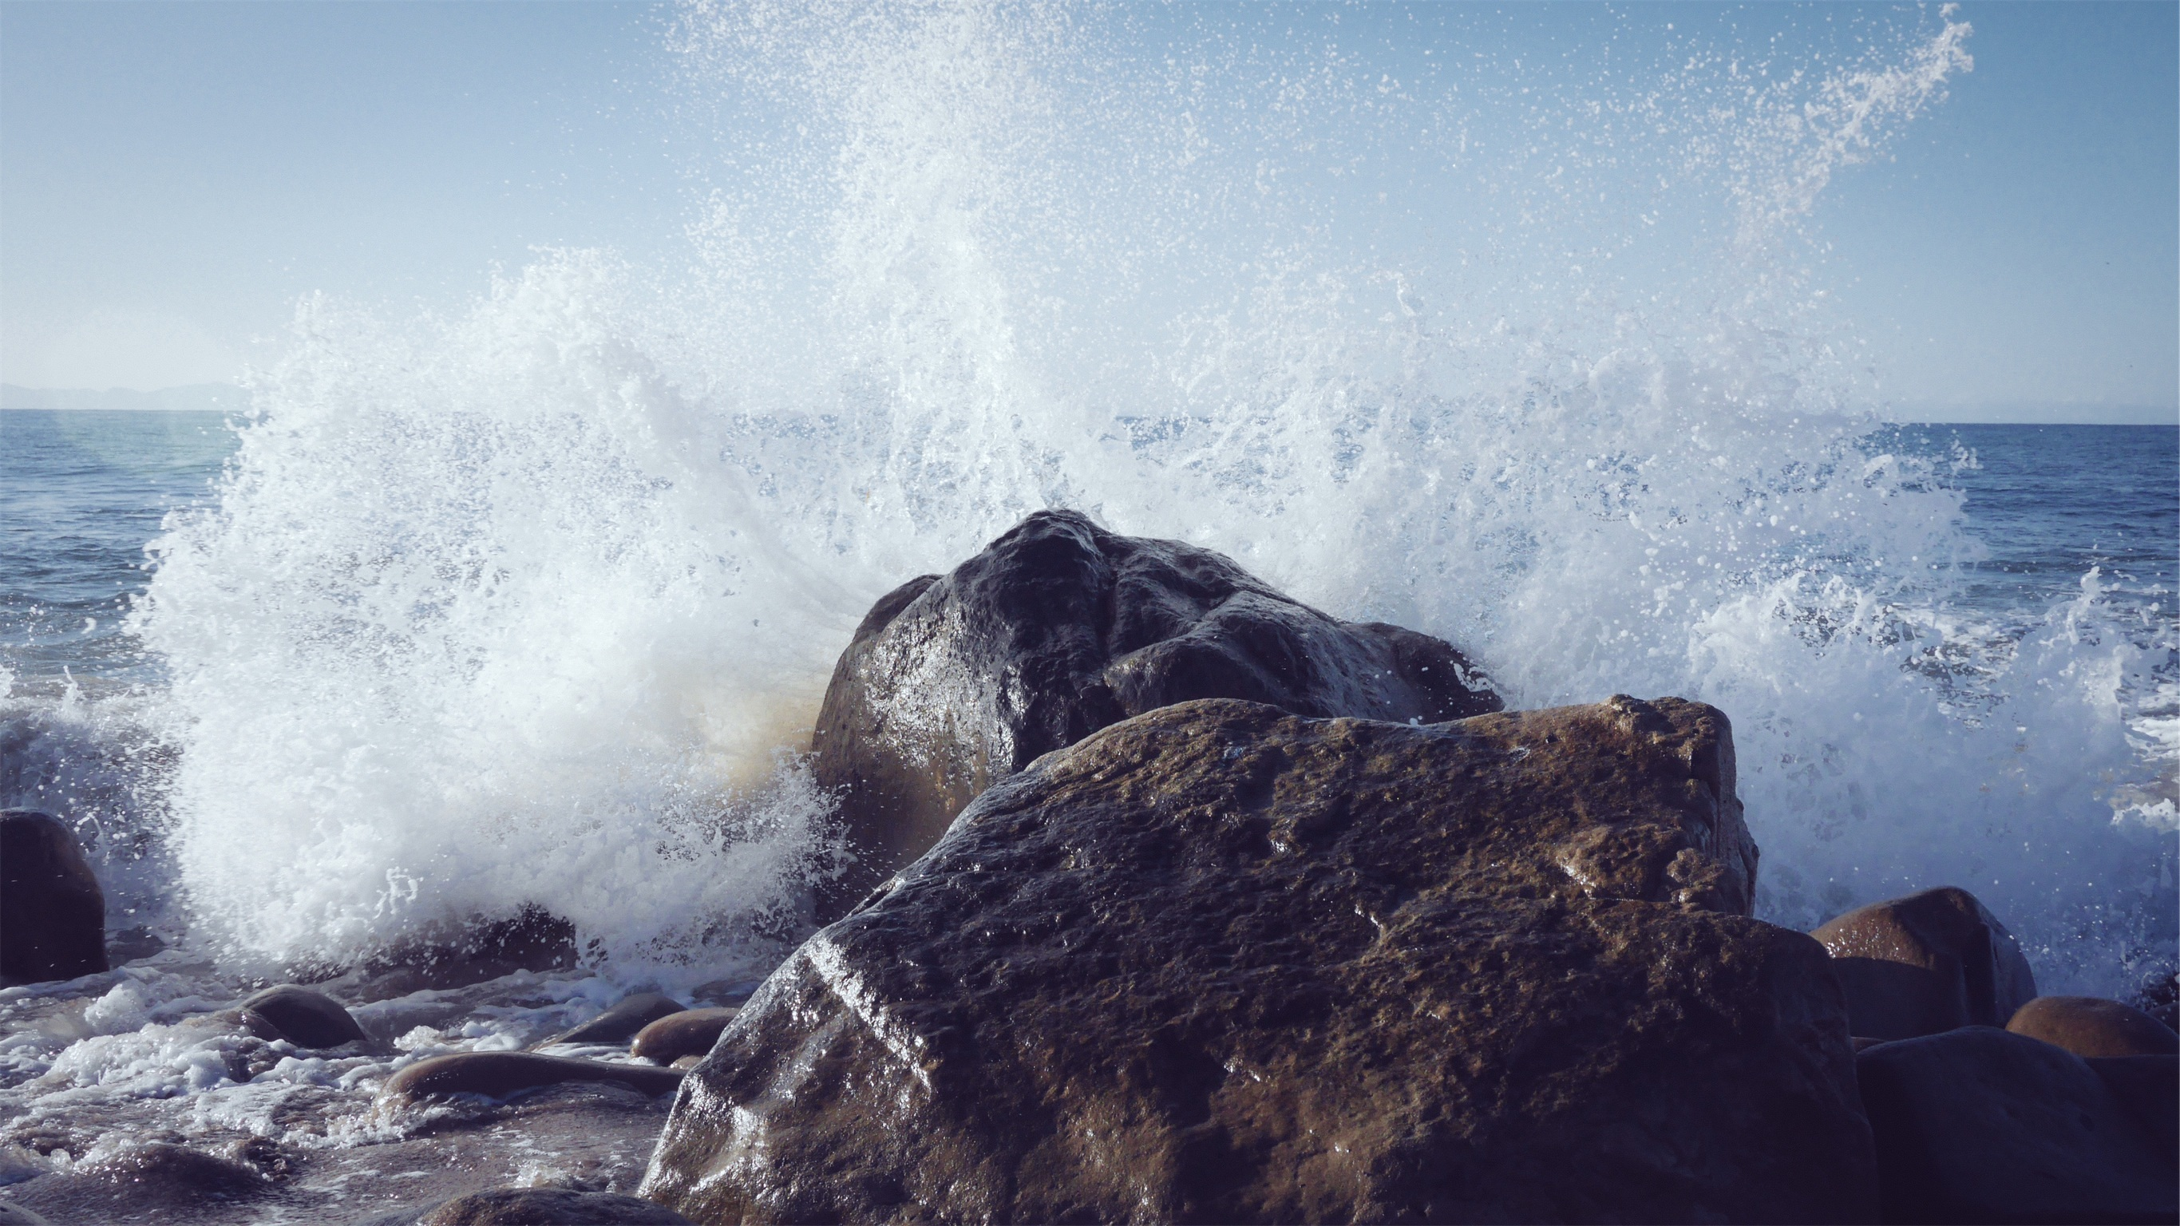
Faithful One
Brian Doerksen
Jan
Faithful One, so unchanging,
Ageless One, you’re my rock of peace.
Lord of all, I depend on you,
I call out to you again and again.
I call out to you again and again.

Slide 3
Faithful One
Brian Doerksen
Jan
You are my rock in times of trouble.
You lift me up when I fall down.
All through the storm your love is the anchor, my hope is in you alone.

Slide 4

Welcome to the Worship of the Lord!
Bethlehem Lutheran Church
Belonging to Christ, Sharing Christ on the North Shore and Beyond!
ANNOUNCEMENTS

Slide 5
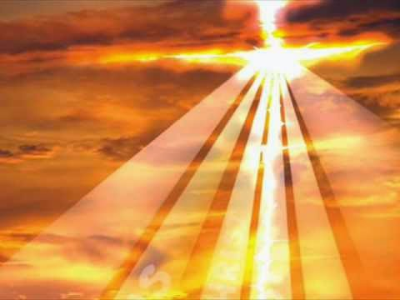
CONFESSION AND FORGIVENESS
Blessed be the holy Trinity, one God, who looks upon us with compassion, forgives our sin, and heals our lives.
Amen.
Let us confess our sin in the presence of God and of one another. (Silence is kept for reflection.)
Have mercy, O God, against you, you alone, we have sinned. In your compassion, cleanse us from our sin and take away our guilt. Create in us a new heart and give us a steadfast spirit. Do not cast us away, but fill us with your Holy Spirit and restore your joy within us. Amen.

Slide 6
As tender as parent to child, so deep is God’s compassion for you. As high as heaven is above earth, so vast is God’s love for you. As far as east is from west, so far God removes your sin from you, renewing your life through Jesus Christ. Blessed be God who crowns us with mercy and love.
Blessed be God forever.

Slide 7
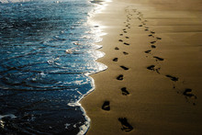
Just a Closer Walk with Thee
Verse 1
I am weak but thou art strong;
Jesus, keep me from all wrong.
I’ll be satisfied as long
As I walk, let me walk close to Thee.
Refrain
Just a closer walk with Thee,
Grant it, Jesus, is my plea.
Daily walking close to Thee,
Let it be, dear Lord, let it be.

Slide 8
Just a Closer Walk with Thee
Verse 2
Thro’ this world of toil and snares,
If I falter, Lord, who cares?
Who with me my burden shares?
None but Thee, dear Lord, none but Thee.
Refrain
Just a closer walk with Thee,
Grant it, Jesus, is my plea.
Daily walking close to Thee,
Let it be, dear Lord, let it be.

Slide 9
Just a Closer Walk with Thee
Verse 3
When my feeble life is o’er,
Time for me will be no more;
Guide me gently, safely o’er
To Thy kingdom shore, to Thy shore.
Refrain
Just a closer walk with Thee,
Grant it, Jesus, is my plea.
Daily walking close to Thee,
Let it be, dear Lord, let it be.

Slide 10
The grace of our Lord Jesus Christ,
the love of God, and the communion
of the Holy Spirit be with you all.
And also with you.

Slide 11

I Will Call Upon the Lord
I will call upon the Lord
Who is worthy to be praised.
So shall I be saved from my enemies.
The Lord liveth, and blessed be the Rock, and let the God of my salvation be exalted.
The Lord liveth, and blessed be the Rock, and let the God of my salvation be exalted.

Slide 12

PRAYER OF THE DAY
O God, with all your faithful followers of every age, we praise you, the rock of our life. Be our strong foundation and form us into the body of your Son, that we may gladly minister to all the world, through Jesus Christ, our Savior and Lord. Amen.

Slide 13
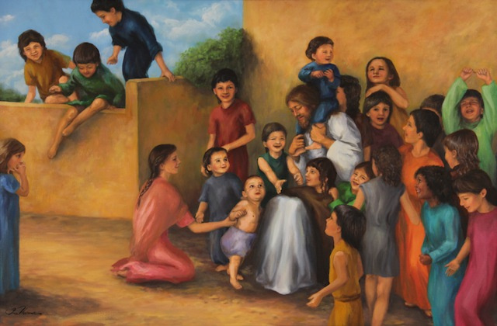
We welcome the children to our worship!

Slide 14

THE WORD
Isaiah 51:1-6
Word of God, Word of Life.
Thanks be to God.

Slide 15
Psalm 138
¹ I will give thanks to you, O Lord, with my whole heart; before the gods I will sing your praise.
² I will bow down toward your holy temple and praise your name, because of your steadfast love and faithfulness; for you have glorified your name and your word above all things.

Slide 16
Psalm 138
³ When I called, you answered me; you increased my strength within me.
⁴ All the rulers of the earth will praise you, O Lord, when they have heard the words of your mouth.
⁵ They will sing of the ways of the Lord,
that great is the glory of the Lord.

Slide 17
Psalm 138
⁶ The Lord is high, yet cares for the lowly,
perceiving the haughty from afar.
⁷ Though I walk in the midst of trouble, you keep me safe; you stretch forth your hand against the fury of my enemies; your right hand shall save me.
⁸ You will make good your purpose for me; O Lord, your steadfast love endures forever; do not abandon the works of your hands.

Slide 18
THE WORD
Romans 12:1-8
Word of God, Word of Life.
Thanks be to God.

Slide 19
The holy gospel according to Matthew, the 16th Chapter
Glory to you, O Lord.
Matthew 16:13-20
The gospel of the Lord.
Praise to you, O Christ.

Slide 20

MESSAGE
Pastor Calvin Konop

Slide 21
Here on Jesus Christ I Will Stand
Adapt. Greg Scheer
Jan
Refrain:
Here on Jesus Christ I will stand.
He’s the solid rock of my life.
He’s the solid rock of my life.
He’s the solid rock of my life.

Slide 22
Here on Jesus Christ I Will Stand
Adapt. Greg Scheer
Jan
Verse 1:
There’s no other place I can hide
Till the storm that rages subsides.
My voice cries to God from the flood,
And I’m saved because of his blood.

Slide 23
Here on Jesus Christ I Will Stand
Adapt. Greg Scheer
Jan
Refrain:
Here on Jesus Christ I will stand.
He’s the solid rock of my life.
He’s the solid rock of my life.
He’s the solid rock of my life.

Slide 24
Here on Jesus Christ I Will Stand
Adapt. Greg Scheer
Jan
Verse 2:
It is not the work of my hands
that has washed away all my sins.
I’m redeemed, and all of my days,
Jesus Christ will be my heart’s praise.

Slide 25
Here on Jesus Christ I Will Stand
Adapt. Greg Scheer
Jan
Refrain:
Here on Jesus Christ I will stand.
He’s the solid rock of my life.
He’s the solid rock of my life.
He’s the solid rock of my life.

Slide 26
Here on Jesus Christ I Will Stand
Adapt. Greg Scheer
Jan
Verse 3:
When my days on this earth are done,
And I stand at God’s holy throne,
My heart will not have any fear;
In Christ’s righteousness I am here.

Slide 27
Here on Jesus Christ I Will Stand
Adapt. Greg Scheer
Jan
Refrain:
Here on Jesus Christ I will stand.
He’s the solid rock of my life.
He’s the solid rock of my life.
He’s the solid rock of my life.

Slide 28
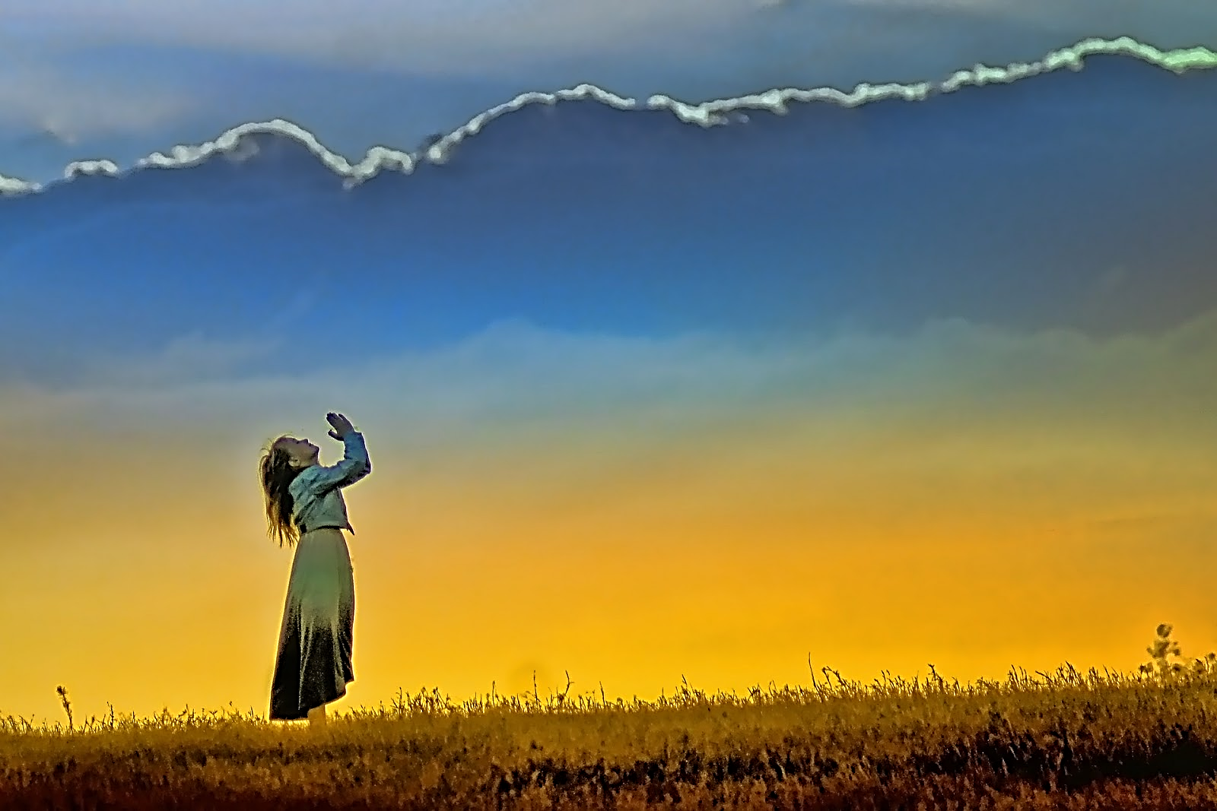
I believe in God, the Father almighty,
creator of heaven and earth.
I believe in Jesus Christ, God’s only Son, our Lord.
who was conceived by the Holy Spirit,
born of the virgin Mary,
suffered under Pontius Pilate,
was crucified, died, and was buried;
he descended to the dead.
On the third day he rose again;
he ascended into heaven,
he is seated at the right hand of the Father,
and he will come to judge the living and the dead.
I believe in the Holy Spirit,
the holy catholic church,
the communion of saints,
the forgiveness of sins,
the resurrection of the body,
and the life everlasting. AMEN.
With the whole church,
Let us confess our faith
This Photo by Unknown Author is licensed under CC BY-NC-ND

Slide 29
With bold trust in God’s unfailing provision,
we pray for the church, those in need,
and all of creation.
(A brief silence)
.
Let us pray for God’s people
Merciful God,
…receive our prayer.
This Photo by Unknown Author is licensed under CC BY-NC-ND

Slide 30
The peace of Christ be with you always
And also with you.
Let us turn to our neighbor and offer signs of peace and love to which we are called.
This Photo by Unknown Author is licensed under CC BY-NC-ND

Slide 31
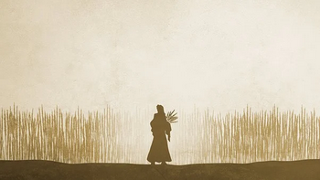
OFFERING

Slide 32
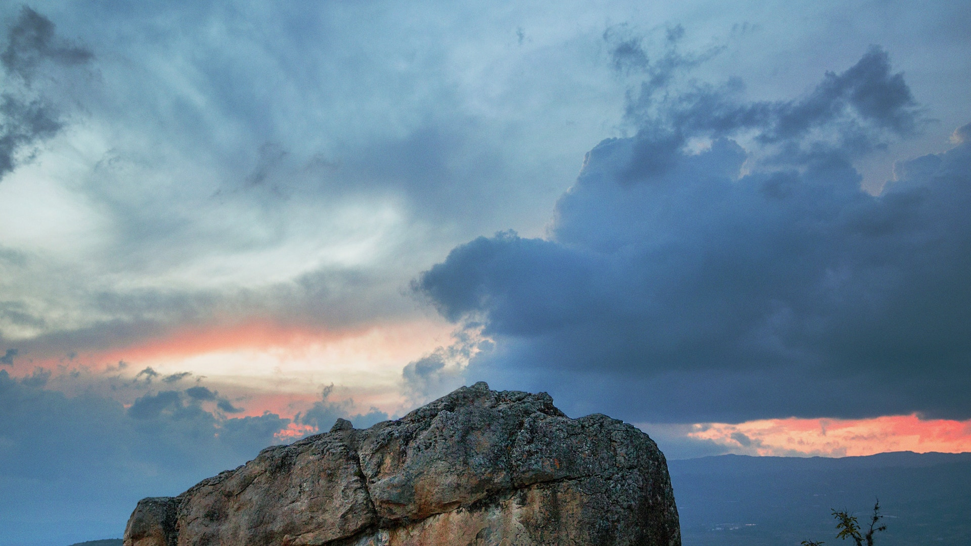
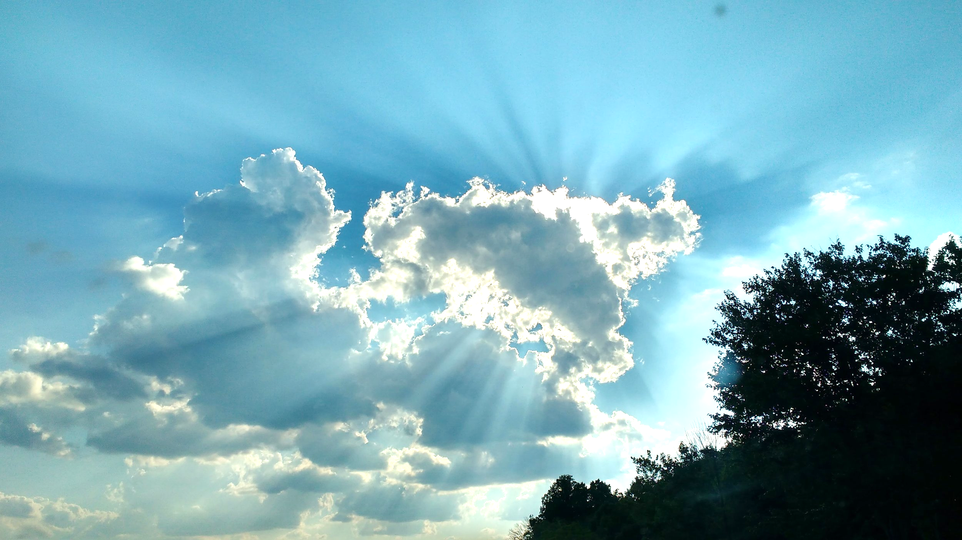
We Are an Offering
Dwight Liles
Copyright 1984 Word Music, LLC
We lift our voices, we lift our hands,
We lift our lives up to you;
we are an offering.
Lord, use our voices,
Lord use our hands,
Lord, use our lives, they are yours:
we are an offering.

Slide 33
We Are an Offering
Dwight Liles
Copyright 1984 Word Music, LLC
All that we have, all that we are,
All that we hope to be,
we give to you, we give to you.
We lift our voices,
we lift our hands,
We lift our lives up to you:
we are an offering,
We are an offering.

Slide 34
OUR OFFERING PRAYER
God of goodness and growth,
All creation is yours, and your faithfulness is sure. Word and water, wine and bread; these are signs of your abundant grace. Receive the gifts we bring, and nourish us to proclaim your abiding love in our communities and in the world, through Jesus Christ, our strength and our song. Amen.

Slide 35
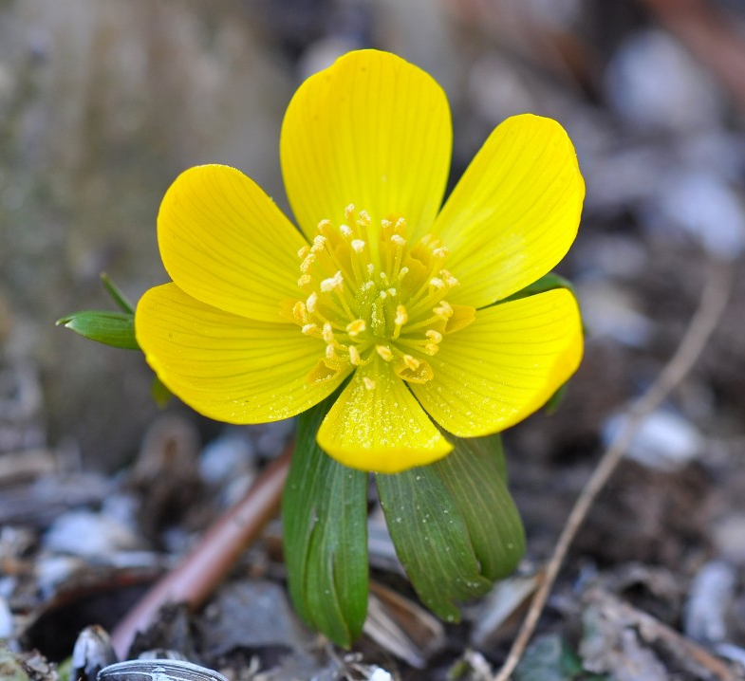
THE GREAT THANKSGIVING
The Lord be with you.
And also with you.
Lift up your hearts.
We lift them to the Lord.
Let us give thanks to the Lord our God.
It is right to give our thanks and praise.

Slide 36
PREFACE
It is indeed, right, our duty and our joy, that we should at all times and in all places give thanks and praise……..

Slide 37
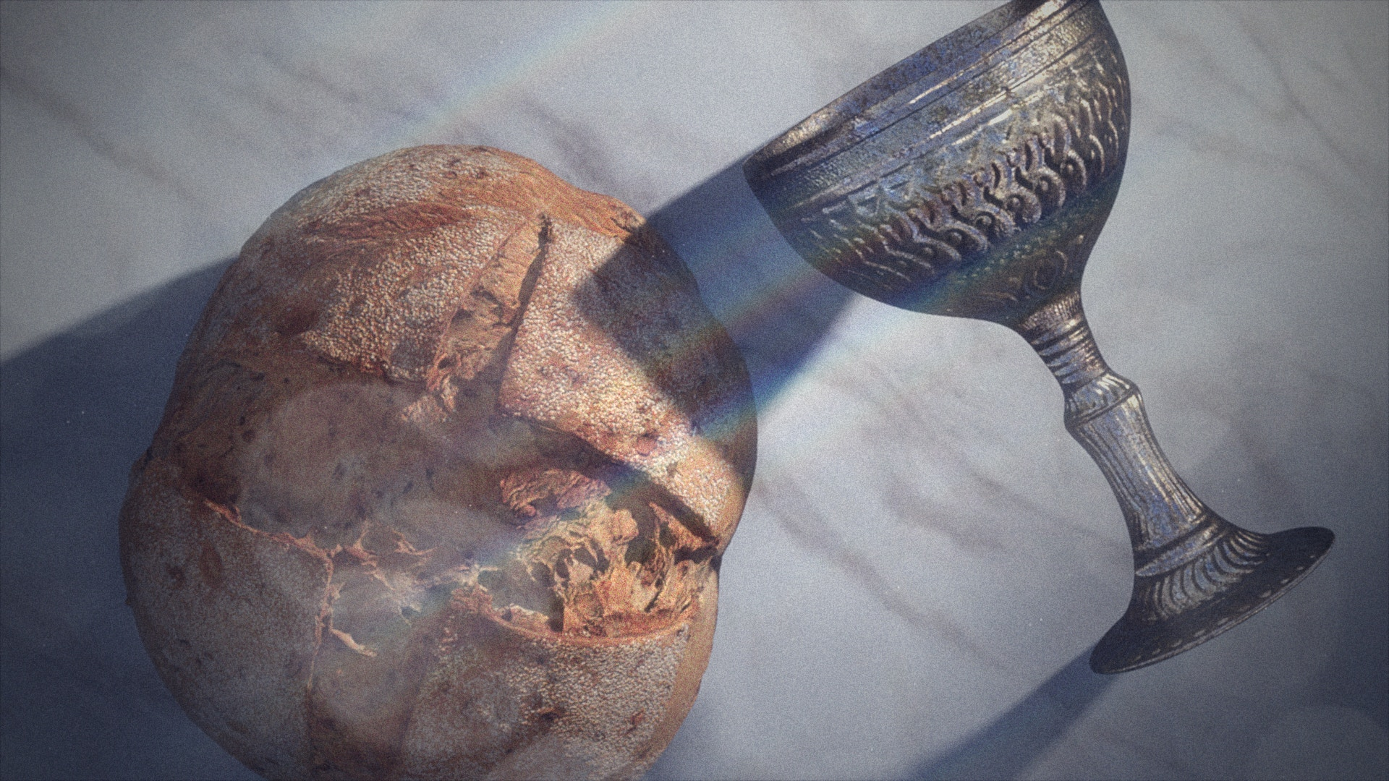
THE WORDS OF INSTITUTION

Slide 38
THE LORD’S PRAYER
Our Father, who art in heaven,
Hallowed by thy name,
Thy kingdom come,
Thy will be done,
On earth as it is in heaven.
Give us this day our daily bread,
And forgive us our trespasses,
As we forgive those who trespass against us;
And lead us not into temptation,
But deliver us from evil.
For thine is the kingdom,
And the power, and the glory,
Forever and ever. Amen.

Slide 39
INVITATION TO THE TABLE:
Taste and see that
the Lord is good.
All are welcome!

Slide 40
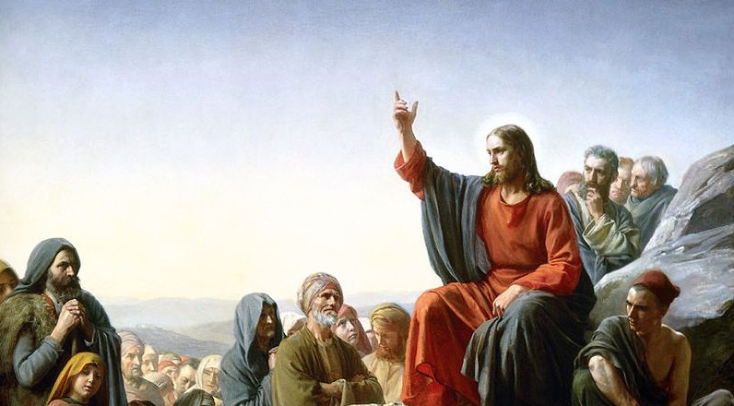
Come to the Table
ELW 481
Martin Nystrom, Claire Cloninger
Come to the table of mercy,
prepared with the wine and the bread.
All who are hungry and thirsty,
come, and your souls will be fed.

Slide 41
Come to the Table
ELW 481
Martin Nystrom,
Claire Cloninger
© 1991 Integrity Hosanna Music
Come at the Lord's invitation;
receive from his nail-scarred hand.
Eat of the bread of salvation;
drink of the blood of the Lamb.

Slide 42
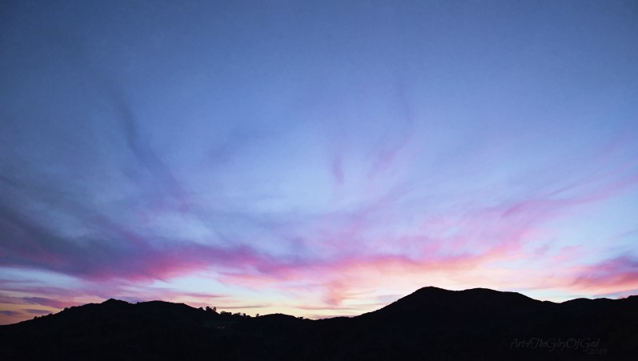
Seek Ye First

Slide 43
Seek ye first the kingdom of God
And its righteousness;
And all these things shall be added unto you.
Hallelu, Hallelujah!

Slide 44
Ask, and it shall be given unto you;
Seek, and you shall find.
Knock, and the door shall be opened unto you.
Hallelu, Hallelujah!

Slide 45
We do not live by bread alone,
But by every word
That proceeds out from the mouth of God.
Hallelu, Hallelujah!

Slide 46

BLESSING
May the body and blood of our Lord Jesus Christ, strengthen you and keep you in grace unto everlasting life.
Amen.

Slide 47
PRAYER AFTER COMMUNION
Compassionate God,
Through the gifts of bread and wine our hearts are filled with the abundance of your love. Strengthen us that we, through this holy meal, may share your love freely, as you have shared with us. We ask this in the name of Jesus, through the Spirit nourishing us now and forever. Amen.

Slide 48
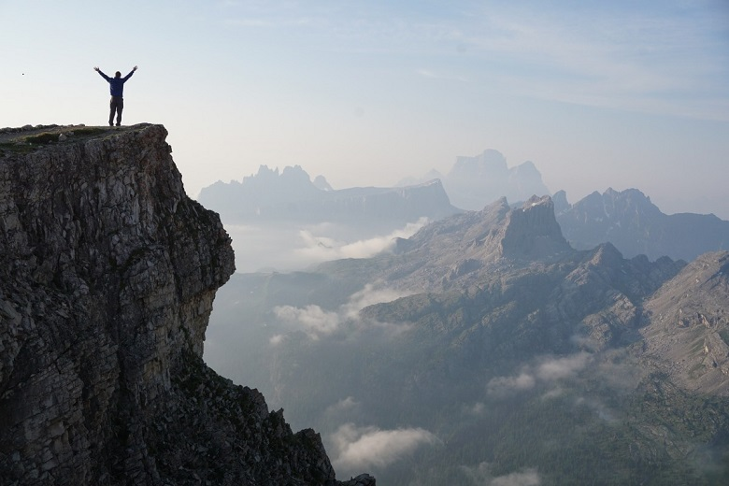
The peace of God, which surpasses all understanding, keep your hearts and minds in Christ Jesus.
Amen.

Slide 49

Build Us Up, Lord
Verse 1:
Build us up, Lord, build us up;
Set in us a strong foundation.
Lead us to do your holy will;
Form and shape your new creation.
Build us up, Lord, build us up;
as we guide and teach each other,
Help us to share your love with the world:
ev’ry sister, ev’ry brother.
Mark Glaeser and Donna Hanna
©2003 Augsburg Fortress

Slide 50
Build Us Up, Lord
Mark Glaeser and Donna Hanna
©2003 Augsburg Fortress
Refrain:
Growing in Christ,
we plant seeds for the kingdom;
We follow in faith what’s begun!
Lord, set in our hearts
the pow’r of your word
To spread the news of your Son!

Slide 51
Build Us Up, Lord
Verse 2:
Build us up, Lord, build us up;
let our lives reflect your glory.
Cast away all our doubts and fears;
help us tell the world your story.
Build us up, Lord, build us up;
help us bear good fruit for you,
Lord, give us vision and keep us sure.
Grant us faith that’s steadfast and true.
Mark Glaeser and Donna Hanna
©2003 Augsburg Fortress

Slide 52
Build Us Up, Lord
Mark Glaeser and Donna Hanna
©2003 Augsburg Fortress
Refrain:
Growing in Christ,
we plant seeds for the kingdom;
We follow in faith what’s begun!
Lord, set in our hearts
the pow’r of your word
To spread the news of your Son!

Slide 53
Go in peace.
Love your neighbor.
….Thanks be to God.

Slide 54
Build Us Up, Lord
Verse 1:
Build us up, Lord, build us up;
Set in us a strong foundation.
Lead us to do your holy will;
Form and shape your new creation.
Build us up, Lord, build us up;
as we guide and teach each other,
Help us to share your love with the world:
ev’ry sister, ev’ry brother.
Mark Glaeser and Donna Hanna
©2003 Augsburg Fortress

Slide 55
Build Us Up, Lord
Mark Glaeser and Donna Hanna
©2003 Augsburg Fortress
Refrain:
Growing in Christ,
we plant seeds for the kingdom;
We follow in faith what’s begun!
Lord, set in our hearts
the pow’r of your word
To spread the news of your Son!

